Slide 1
Hierarchical Task and Motion Planning in the Now
L. Kaelbling, Tomas Lozano-Perez, 2011
Presenter: Andrew Wu
10/25/2022

Slide 2
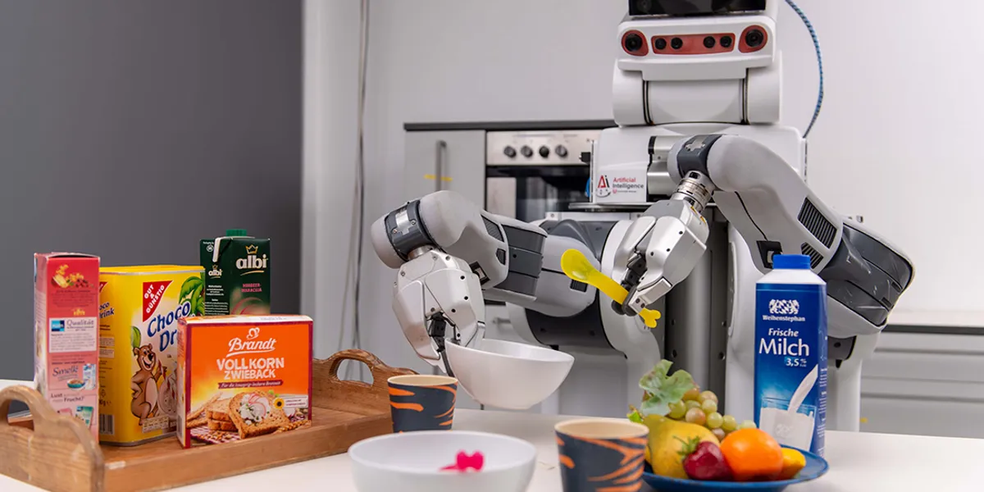
Motivation and Main Problem
The overall planning problem, especially in generalized environments.
From Perez:
“ An enduring goal of AI and robotics has been to build a robot capable of robustly performing a wide variety of tasks in a wide variety of environments; not by sequentially being programmed (or taught) to perform one task in one environment at a time, but rather by intelligently choosing appropriate actions for whatever task and environment it is facing. This goal remains a challenge. “
Image courtesy of Ease

Slide 3
Motivation and Main Problem
Let’s ground ourselves in the history of deep RL since we’ve mostly covered that
1989: Q-Learning
1991: TD-Gammon
1992: REINFORCE
1992: Experience Replay
1994: SARSA
1999: Nvidia invents the GPU
2007: CUDA released
2011: We are here!
2012: Arcade Learning Environment (ALE)
2013: DQN
Timeline courtesy of here

Slide 4
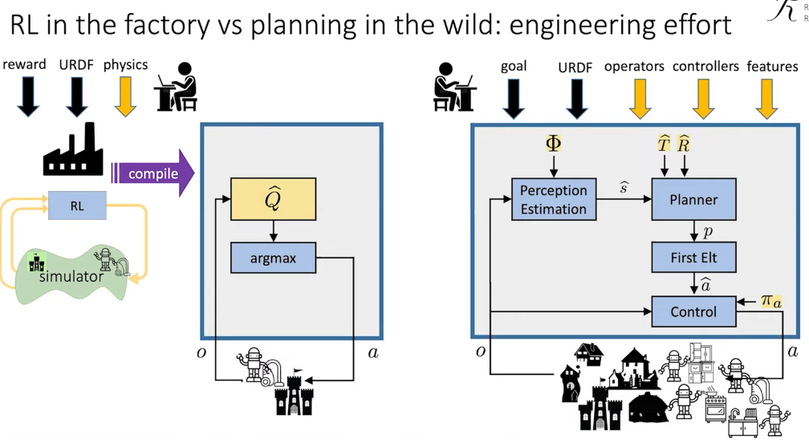
Image from a 2021 talk by Tomas Lozano-Perez

Slide 5
Image from a 2020 talk by Leslie Kaelbling

Slide 6
Motivation and Main Problem
How do we create such a general agent?
For this paper’s idea:
For specified domains we can combine ideas from symbolic task planners and low level motion planning to create an overall planner
To reduce an exponential search, we can be aggressively hierarchical in constructing our plan
In non-deterministic outcomes from actions, we can back up and re-evaluate our plan after every action

Slide 7
Context / Related Work / Limitations of Prior Work
Using Abstraction to Interleave Planning and Execution (Nourbakhsh, 1997)
Hierarchical Reasoning
No Geometric Reasoning
Manipulation Planning Among Movable Obstacles (Stilman et. al, 2007)
Similar DFS-like planning
No Task Planning, specific manipulation task
Sampling-based Motion and Symbolic Action Planning with Geometric and Differential Constraints (Plaku, Hager, 2010)
Similar formulation of integrated motion and symbolic action planning but without hierarchy and with utility-based actions
Nothing really integrated Hierarchy, Task planning, and Motion planning at the geometric level!

Slide 8
Finite Domain Representation
Let’s borrow some notation from logical representation
Fluents
Symbolic predicate applied to list of arguments (constants or variables)
All constants is a ground fluent which values are determined by the state
World States
Complete, detailed description of domain geometrically and non-geometrically
Goals
Set of world states described using a conjunction of fluents
Operators
Primitive actions with STRIPS-style form

Slide 9
Infinite Domain Representation
Suggesters
maps bindings of variables to restricted domains
Inferential attachments, procedural operators, contradicts attachment, non-deterministic side effects, and more!

Slide 10
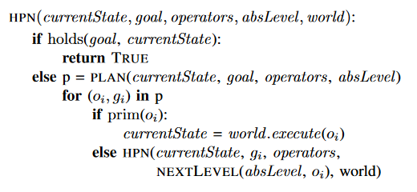
Algorithm
Image from the paper

Slide 11
Example: Washing domain
Fluents:
In(O, R): True if Object O contained in region R
Overlaps(O, R): True if O overlaps R
ClearX(R, O1, O2, …): True if R is not overlapped with any Os
Holding(): Returns object grasped, otherwise None
Clean(O): True if O is clean

Slide 12
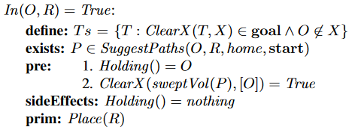
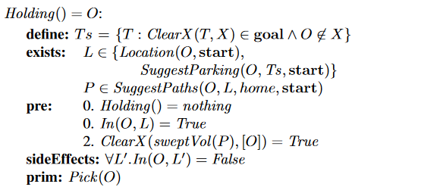
Example: Washing domain
Place operator
Pick operator
Image from the paper

Slide 13
Let’s remind ourselves:
Image from the paper

Slide 14
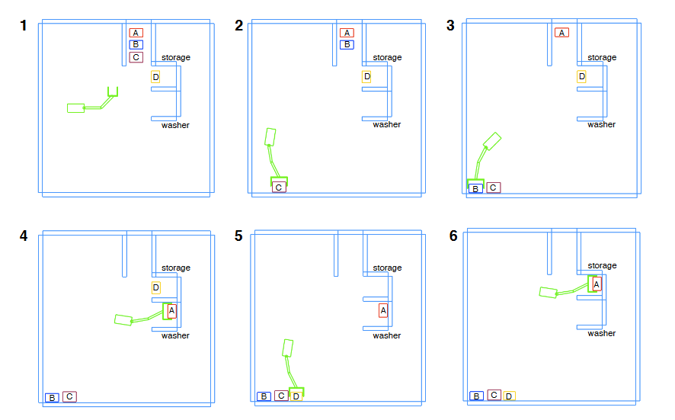
Image from the paper

Slide 15
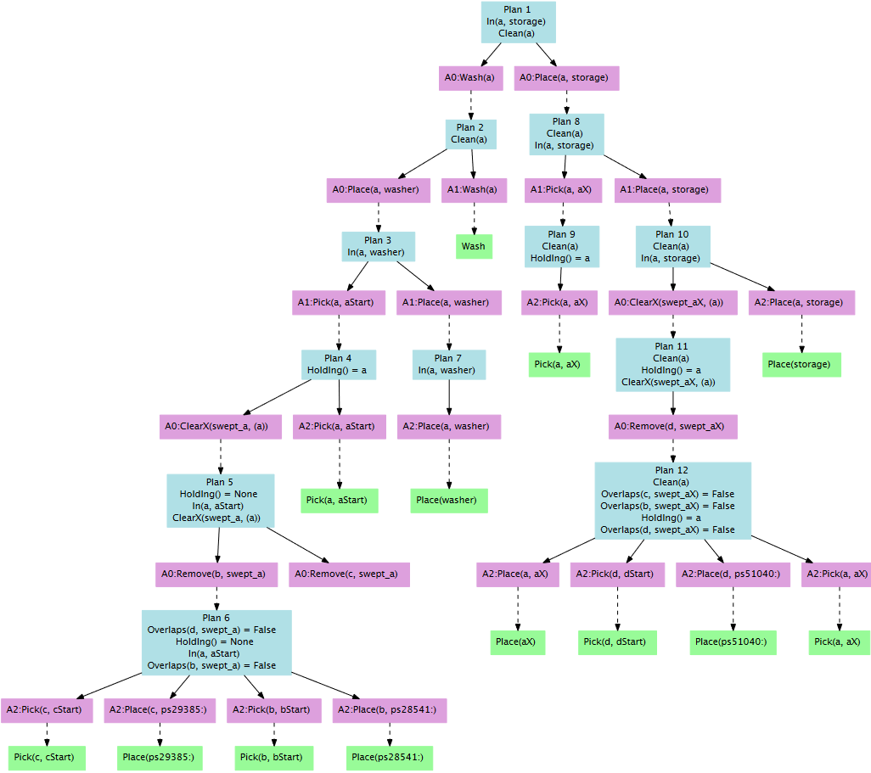
Image from the paper

Slide 16
Image from the paper

Slide 17
Correctness
Correctness Criterion:
If a goal state is reachable from the start in a sequence of actions, then HPN should reach it.
HPN can do this under:
Each abstraction level has complete and correct formalization of primitive actions of domain
Start has static connectivity with that domain
Goal reachable from start

Slide 18
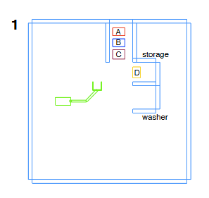
Experimental Setup
Pretty ill defined setup
Seems to be simulation in a “household” domain
6 rooms now, objects of “vacuum”, “mop”, “junk”
Clean all rooms (vacuum and mop + move all junk into closet)
Swap location of two blocks
x 6?
Image from the paper

Slide 19
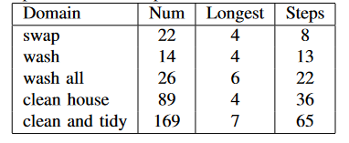
Experimental Results
Example rollout w/ non-deterministic implementation
Search is exponential in length of plan:
None of pre-2011 planners could solve!
Image from the paper

Slide 20
Discussion of Results
Hierarchy helps!
Being “aggressively hierarchical” in a greedy-esque fashion reduces the search space one considers
Able to solve tasks that has non-serializable goal “swap”

Slide 21
Critique / Limitations / Open Issues
Key Limitations:
Needs observable domain
Needs formalized actions
Needs good hierarchical abstraction which is domain dependent
Not Optimal
And that can be okay!
Sampling in infinite space could be better
Experiments could be a lot more thorough/better
but really nothing to compare to
Image from a 2020 talk by Leslie Kaelbling

Slide 22
Future Work for Paper / Reading
From a 2020 talk by Leslie Kaelbling, she states in a paraphrased fashion that: While there is enormous progress in RL and IL, they do not yield solutions for generally intelligent autonomous agents
There needs to be human insight to impart algorithmic and structural biases to complement these algorithms
Extension questions:
How do we deal with a partially observable domain?
How do we get away from constructing the hierarchies manually? Formalizing the actions?
With models such as GATO existing now, does Kaelbling’s ideas still hold?

Slide 23
Extended Readings
The 2020 survey paper on TAMP shows the derivative works that tackle some of the previous problems
Next two papers are all derivative works!
Integrating Task-Motion Planning with Reinforcement Learning for Robust Decision Making in Mobile Robots (Jiang et al, 2018)
TAMP with RL
Learning Neuro-Symbolic Skills for Bilevel Planning (Silver, Athalye et al, 2022)
Learning policies w/ learning operators and samplers
Others:
Long-Horizon Manipulation of Unknown Objects via Task and Motion Planning with Estimated Affordances (Curtis, Fang, et al, 2021)
Working with no models

Slide 24
Summary
Tackling general, long-horizon planning in a well-defined domain
RL and IL have long struggled at long-horizon, general tasks
Prior works do not integrate Task AND Motion planning or include hierarchy
Hierarchy reduces search space DFS-like algorithm allows for re-evaluation on non-deterministic actions
Surprisingly powerful planning although in formalized environments

